Slide 1

End-of-Year Performance Evaluation Calibration Session
Talent Development | September 2025

Slide 2
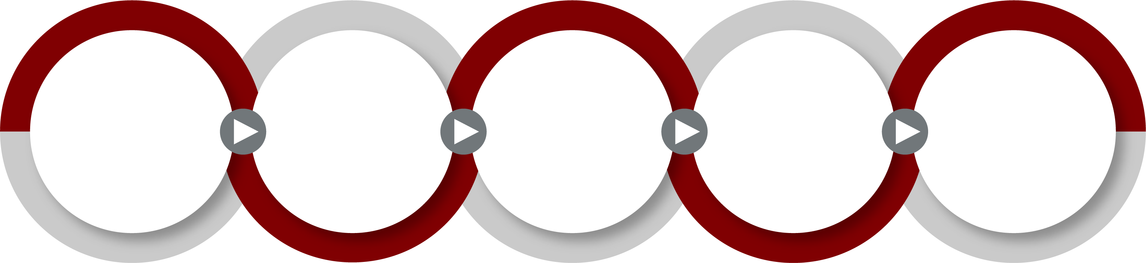
Woodward’s Talent Review Process
June - March
Facilitate, Launch, and Execute Strategic Talent Development Plans
Intentional Accelerated Development for Strategic Talent
Identifying Strategic Talent and Talent Pools for Critical Roles
Managing & Recognizing Performance
Learning & Development Support
Build a Talent Pipeline
Goal Setting
Assessing Performance
Performance Conversations
Compensation Decisions
Leadership Development Programs
Functional Learning
Professional Learning
Development Planning & Conversations
Career Conversations
Talent Reviews
Identifying potential
Assessing Readiness
Individual Development Plans
Accelerated Development Programs
Rotation Programs
Job/ Stretch Assignments
Ready Now Talent
Bench Depth
Diversity of Talent
Notes:
Say: Every year we engage in the Talent Review process with a singular purpose, to build a “Ready Now” Talent Pipeline. It’s easy to fall into the trap that the work is done after the talent has been identified and reviewed in the 9-box. However, that’s just the beginning. As leaders, we must execute at ever step of the process for successful results.
The foundation of this process is Performance Management, including setting goals, assessing and discussing performance, and our yearly merit process. When we effectively manage performance, it sets us up for success in building the talent pipeline. Formal learning and development supports members in their areas of growth.
By the time you as leaders engage in Career Conversations, you should have a good basis to broach the conversation around career development and preferences of each member. This information supports assessing potential and calibrating talent.
But keep in mind– as I said previously– if we stop at identification, we have done nothing. The whole point of the talent review is to identify the right people to invest additional development efforts in so that we accelerate development. This is where we are today and need your support to achieve.
ORIGINAL: This visual shows you how the many aspects of performance, learning, and development fit together to build a ready now pipeline of talent. But keep in mind– as I said previously– if we stop at identification, we have done nothing. The whole point of the talent review is to identify the right people to invest additional development efforts in so that we accelerate development.

Slide 3
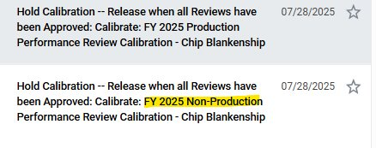
Notes:
Use this slide only if you have to complete both Calibration Tasks.

Slide 4
The purpose of holding a calibration session is:
Improve Accuracy of Performance Ratings & Differentiate Performance
Clarify Performance Standards to Mitigate Bias
Increase Credibility of Performance Evaluation Process
Proximity Bias
You give a higher rating to those colleagues with whom you spend more time. For example, in a hybrid work environment you are likely to rate your in-office member higher than some who works remotely.
Recency Bias
You rate recent achievements more highly than those at the beginning of the year.
Similarity Bias
You are more favorable towards those like you. For example, you could be more favorable toward members with similar interests.
Confirmation Bias
You seek information to confirm your pre-existing beliefs.
Leniency Bias
You overlook underperformance because you do not want to create a conflict or because you like the person.
Comparative Bias
You compare colleagues' personality or work style to each other rather than objective criteria.

Slide 5
A Note on Distribution
Team members should be rated based on their results and behaviors aligned to Woodward’s values. Leadership is not forcing a distribution of ratings. If leaders are accurately assessing performance, ratings should be differentiated, and you will use the full rating scale.
For teams of 30 or more, we should expect the following distribution:
Rating | 1 | 2 | 3 | 4 | 5
Suggested Distribution | 2% | 8% | 70% | 15% | 5%
Please Note: This is NOT a forced distribution.
Notes:
ONLY SHARE THIS SLIDE IN CALIBRATION

Slide 6

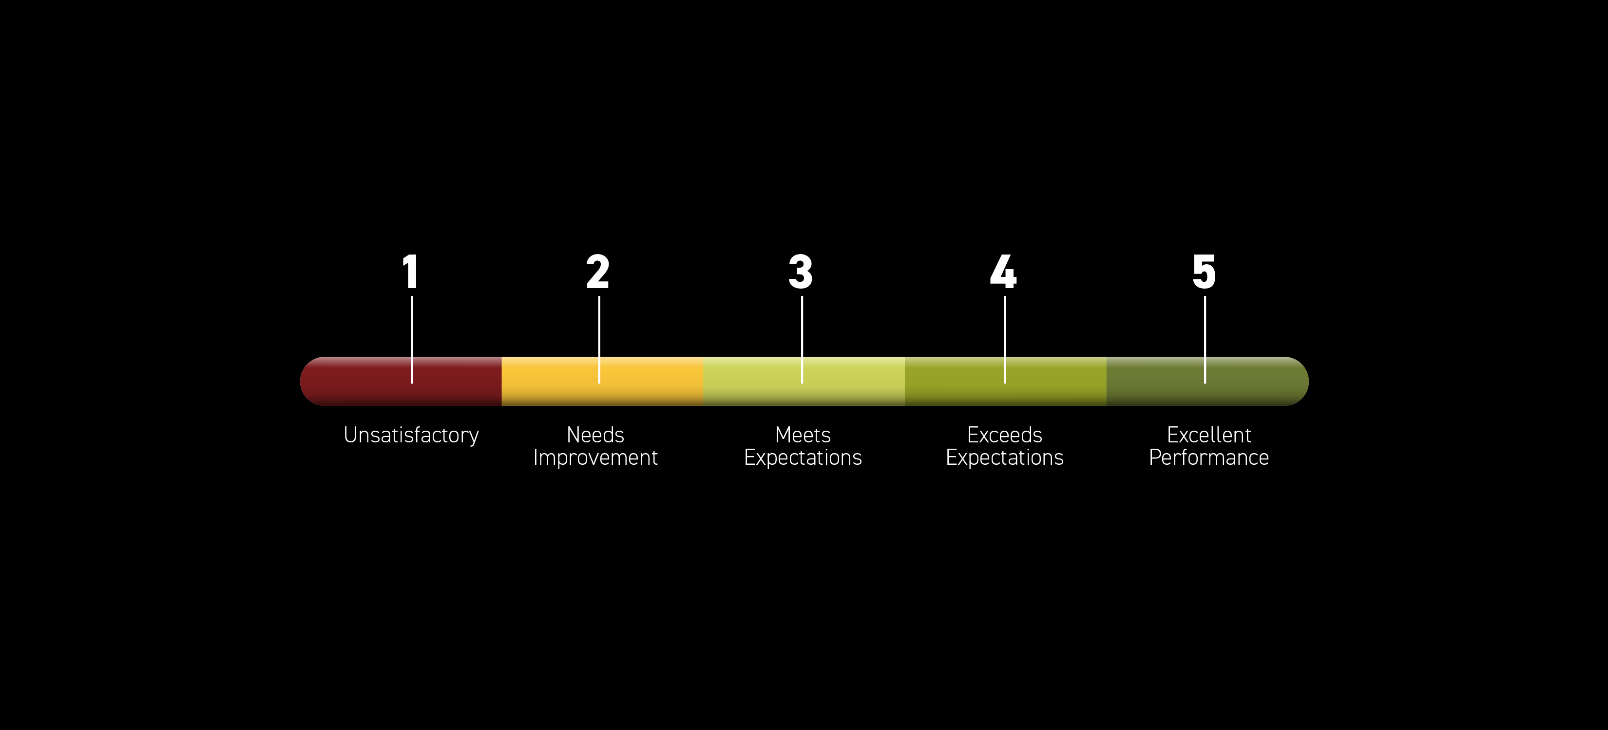
Unsatisfactory: Performance falls significantly below expectations. The individual demonstrates fundamental deficiencies in the skill or competency being assessed, requiring immediate attention and improvement.
1
Needs Improvement: Performance is not meeting expectations but shows some potential for growth. The individual displays weaknesses or areas for development in the skill or competency, requiring focused efforts to improve and meet expectations.
2
Understanding the New 5-Point Rating Scale
Meets Expectations: Performance meets the expected standard for the role or task. The individual demonstrates proficiency in the skill or competency being assessed, meeting the requirements.
3
Exceeds Expectations: Performance goes above and beyond what is expected. The individual demonstrates a high level of proficiency and consistently exceeds the standard for the skill or competency.
4
Excellent Performance: Performance is outstanding and exemplary. The individual consistently demonstrates exceptional skill in the areas being assessed, setting a standard of excellence for others to follow. Their performance significantly contributes to the success and goals of the organization.
5

Slide 7
Questions to Ask During Calibration
1
2
3
4
5
 | UNSATISFACTORY | NEEDS IMPROVEMENT | MEETS EXPECTATIONS | EXCEEDS EXPECTATIONS | EXCELLENT PERFORMANCE
Anchor | Performance falls significantly below expectations. The individual demonstrates fundamental deficiencies in the skill or competency being assessed, requiring immediate attention and improvement. | Performance is not meeting expectations but shows some potential for growth. The individual displays weaknesses or areas for development in the skill or competency, requiring focused efforts to improve and meet expectations. | Performance meets the expected standard for the role or task. The individual demonstrates proficiency in the skill or competency being assessed, meeting the requirements. | Performance goes above and beyond what is expected. The individual demonstrates a high level of proficiency and consistently exceeds the standard for the skill or competency. | Performance is outstanding and exemplary. The individual consistently demonstrates exceptional skill in the areas being assessed, setting a standard of excellence for others to follow. Their performance significantly contributes to the success and goals of the organization.
Questions to ask Leaders: | How does the team member’s performance fall significantly below expectations? Are there fundamental deficiencies in the team member’s skill or competency being assessed? If so, what are some specific examples? Does the team member’s performance require immediate attention and improvement? | How is the team member’s performance below expectations? Does the team member show some potential for growth? If yes, what are the specific areas? Are there displays of weakness or areas of development in the team member’s skill or competency being assessed? If yes, what are some specific examples? Does the team member’s performance require focused efforts to improve? | How does the team member’s performance meet expected standard? Are there displays of proficiency in team member’s skill or competency being assessed? If yes, what are some examples? Does the team member perform adequately and meet basic requirements? If yes, what are some specific examples? | How does the team member’s performance go above and beyond expected standard? Does the team member demonstrate a high level of proficiency and consistently exceed the standards for skills and competency? If yes, what are some examples? Does the team member achieve exceptional results? If yes, what are some specific results? | How is the team member’s performance outstanding and exemplary? Does the team member consistently demonstrate exceptional proficiency and skill in area being assessed? Is the team member consistently setting a standard of excellence for others? If yes, what are some specific examples? How does the team member’s performance significantly contribute to the success and goals of the organization. What are specific examples?

