Slide 1

Performance Evaluations –
HR Partners
Talent Development | July 2025

Slide 2
Agenda
01
02
03
04
05
06
07
Woodward’s Talent Process - Performance
What's New
Timeline
Resources
Roles and Responsibilities
Tools
Questions
Notes:
Thank you for taking the time to join us today. In this session, we will be discussing the upcoming Performance Evaluation process. Our goal is to provide you with key updates, helpful reminders, and valuable resources to ensure a effective evaluation experience.

Slide 3

Woodward’s
Talent Process
July-November
End of Year Performance Evaluation Cycle
Identifying Strategic Talent and Talent Pools for Critical Roles
Intentional Accelerated Development for Strategic Talent
Managing & Recognizing Performance
Learning & Development Support
Build a
Talent
Pipeline
Goal Setting
Assessing Performance
Performance Conversations
Compensation Decisions
Leadership Development Programs
Functional
Learning
Professional Learning
Development Planning & Conversations
Career Conversations
Talent Reviews
Identifying potential
Assessing Readiness
Individual Development
Plans
Accelerated Development Programs
Rotation
Programs
Job/ Stretch Assignments
Ready Now Talent
Bench Depth
Diversity
of Talent
Notes:
As we focus on our Talent Process, we are entering the phase of Managing and Recognizing Performance. This is an opportunity for both team members and leaders to reflect on their accomplishments and contributions over the past fiscal year through Self Evaluations. These evaluations provide a platform to celebrate successes, identify growth opportunities, and align on future goals. HR plays a critical role in fostering a positive and productive experience by guiding and supporting both members and leaders throughout this process.

Slide 4
Performance Process: OVERVIEW
a
a
a
End-of-Year Evaluations
Calibration
Conversations & Goal Setting
4
Notes:
Over the next few months, our efforts will center on End-of-Year Evaluations, the calibration of those evaluations, leaders engaging in meaningful conversations about yearly performance, and setting goals for the upcoming year. This training session will specifically focus on the evaluation process, providing the tools and insights needed to ensure accurate and constructive assessments. Additional training sessions will follow, covering calibration and goal-setting to support a comprehensive and well-rounded approach to performance management. Together, these steps will help drive alignment, growth, and success for both individuals and teams.

Slide 5




What is Updated?
5-point Scale
Small verbiage changes to allow more leader delineation
Refinements
This template will be calibrated similar to Non-Production
Production Performance
Printed Version
Production template has an updated printed version to allow more talking points
Leader will not receive To-Do task until after calibration process.
Leader Step
Notes:
5-Point Scale Enhancements
While the changes to the 5-point rating scale may not be immediately obvious without a direct comparison, the verbiage has been refined based on feedback to better differentiate the anchors. This ensures clearer distinctions between ratings, addressing concerns that some anchors were too similar to make definitive judgments.
Production Performance Templates
For production team members, a specific template introduced during Mid-Year Reviews will continue to be utilized. This approach aims to create consistency and alignment across two templates, establishing a new calibration process. More details about this calibration process will be covered in the upcoming calibration training session.
Printed Evaluation Updates
The printed versions of evaluations have been updated to include more detailed information. For instance, anchors are pulled into the final review to assist with the conversations.
Leader Submission Process Reminder
As a reminder, when a leader submits a review, the system will not immediately trigger a "To-Do: Performance Conversation" notification. End-of-Year evaluations require calibration before finalizing reviews. If any adjustments are made during calibration, leaders will receive notifications to update their reviews accordingly once calibration closes. Once they complete the update, then they will receive the To-Do: Performance Conversation task. If no calibration adjustment is required, once calibration closes, the leader will receive the To-Do: Performance Conversation notification.
In order to print the complete review with rating, the leader will need to complete the To-Do: Performance Conversation

Slide 6
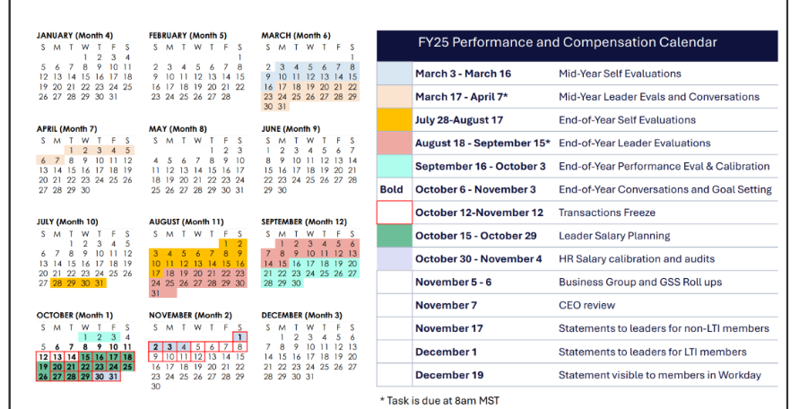
EOY Performance Cycle Timeline – FY25
*Leaders will be able to complete evaluations when team members submit their self-evaluations in Workday. Mass advance of self-evaluations will happen on Aug 15.
Notes:
Here is just an overview of the timeline. This is available to all members and leaders in Workday for you to share at your upcoming meetings with the business. The biggest suggestion to leaders is to complete the reviews as they receive them, this will allow them "extra" time to complete review. A good recommendation is to set time aside each week to complete these as they flow into their in-box. If they wait until the mass-advance on 18 August, then they may be inundated. In other words, the leader does not have to wait until 18 August to begin the Member assessments.

Slide 7


Members
Live Training – 4 Sessions hosted by Talent Development
EOY Performance Evaluation & Conversations for Members Workshop PPT & Support Doc
Team Member Guide for Goals
  Leaders
    Live Training – 4 Sessions hosted by Talent Development
    EOY Performance Evaluation & Conversations for Leaders Workshop PPT & Support Doc
    Leaders Guide to One-on-One Conversations
    Leaders Guide for Goals
7
7
Notes:
We are excited to kick off the second year of our Performance Management process! Building on the foundation we established last year, our primary goal for this year is to maintain consistency by repeating and refining the process. While the trainings have been only slightly updated from last year, they remain a valuable resource for supporting our team members and leaders.
The Talent Development team will be offering Performance Evaluations Training across four different time zones to accommodate everyone. We encourage team members and leaders to participate in these sessions. While the training is optional for most, it is mandatory for new leaders who have joined since the Mid-Year Performance Management process and are experiencing this for the first time. A list of these new leaders has been provided to the Learning team, and the training will be marked as required in the system for them.
In addition to the live trainings, each session can be replicated onsite and delivered by HR partners to their respective teams. The materials for these sessions, including presentation decks and resources, will be made available on our SharePoint site.
Additionally, each training will have an accompanying Support Document that outlines key takeaways. This document can serve as a helpful resource for those who may not attend the training or for HR partners facilitating discussions on the topic.

Slide 8
Roles and Responsibilities
HR Partner
Understand Performance Process
Communicate Timeline to the Business
Encourage members and leaders to attend Live and Onsite Training
Execute your local Training and Communication Plan
  Site specific plans were created, connect with HR Manager/Director for details
Pull Reports for % Completion & follow up with leaders with outstanding reviews
Schedule and Lead Calibration Sessions – TD will provide optional HR training
8
Notes:
Go over each bullet here.

Slide 9
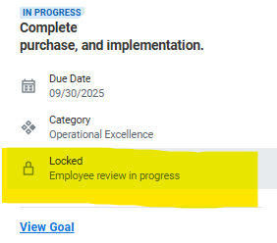
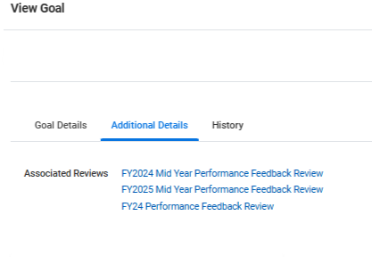

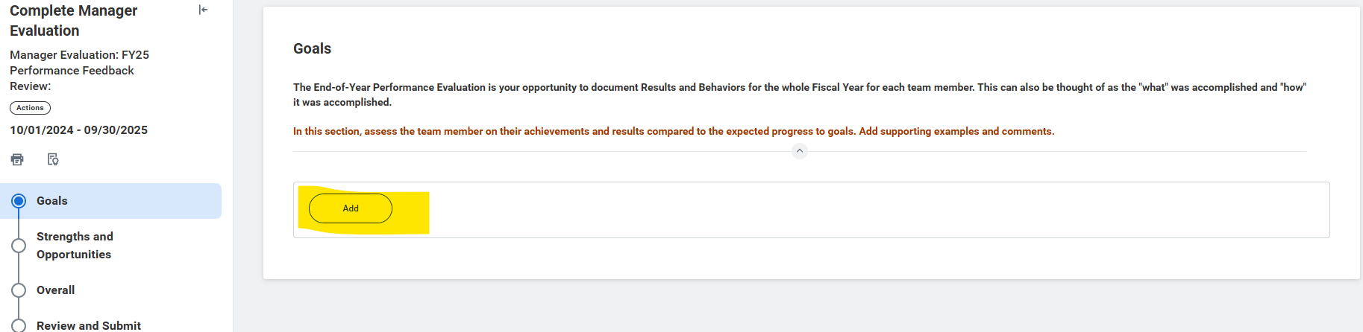
Goals cannot be added during the performance review cycle outside of the performance review process.
Existing goals will pull into your Member’s review automatically unless they have previously been associated with another review
vs
This goal is automatically added This goal will need to be manually added
If you do not see a goal and would like to include it on the current review, select “Add” under the “Goals” section, and choose if from the drop-down list.
A Note on Goals
Goals
Notes:
Walk through slide

Slide 10
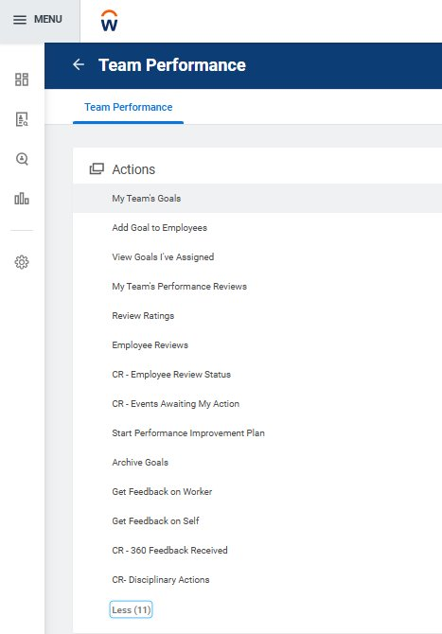
Tools
Reports
  Employee Review Summary
    Rollup of leader and subordinate leaders review status (in progress, complete, average rating)
  Employee Reviews
    Member-specific report, shows leader, Member, status, and rating
SharePoint Link: Talent Development Resource Page
Notes:
As part of the Performance Evaluation process, there are two key reports that will be highly beneficial to reference. These reports are designed to provide valuable insights and help leaders and HR partners navigate the evaluation process effectively. Be sure to utilize these resources as we move forward.
Additionally, leaders have access to the Team Performance Tab, which serves as a centralized hub for performance-related information. This tab offers several options to streamline their workflow, including tools to view review statuses, ratings, goals, and more—all conveniently located in one place.
Click into sharepoint and give a quick note about upcoming Woodward YOU and the temporary spot to find resources for Performance related trainings and support documents.

Slide 11

Questions

